Slide 1

Welcome to our
MATHEMATICS
Class
Prepared by: Mr. Fajardo

Slide 2
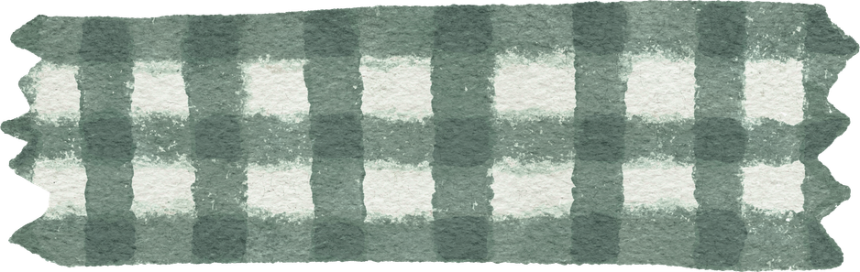
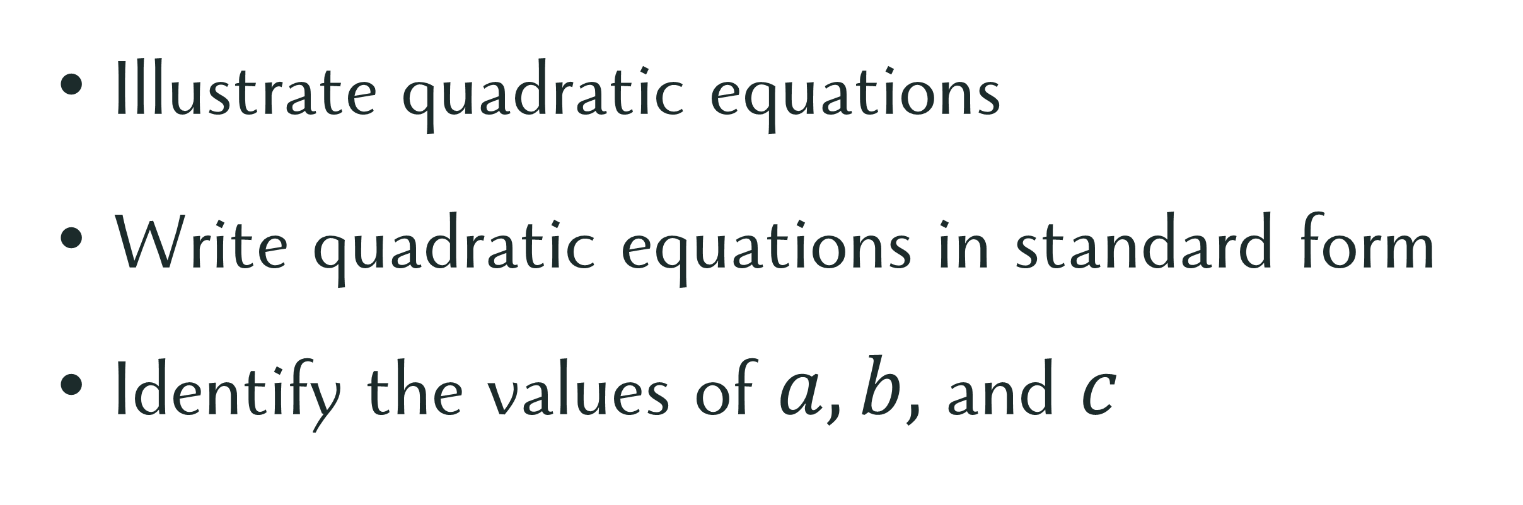
Learning Objectives
Illustrate quadratic equations
Write quadratic equations in standard form
Identify the values of $a, b,$ and $c$

Slide 3
Let’s explore!

Slide 4

Let’s Explore!
After a typhoon caused by a power outage, Juan wants to build a solar-powered generator for his neighbors. He has a rectangular piece of a plywood with an area of $18m^{2}.$ Its length is $3$ meters longer than its width. Juan needs to figure out the dimension of the plywood to avoid wasting it. With a heart full of compassion and a strong desire to make a difference, he’s determined to solve this puzzle and bring back electricity to his community.

Slide 5

Let’s Explore!
After a typhoon caused by a power outage, Juan wants to build a solar-powered generator for his neighbors. He has a rectangular piece of a plywood with an area of $18m^{2}.$ Its length is $3$ meters longer than its width. Juan needs to figure out the dimension of the plywood to avoid wasting it. With a heart full of compassion and a strong desire to make a difference, he’s determined to solve this puzzle and bring back electricity to his community.
What equation represents the area of the rectangular plywood?

Slide 6

Let’s Explore!
After a typhoon caused by a power outage, Juan wants to build a solar-powered generator for his neighbors. He has a rectangular piece of a plywood with an area of $18m^{2}.$ Its length is $3$ meters longer than its width. Juan needs to figure out the dimension of the plywood to avoid wasting it. With a heart full of compassion and a strong desire to make a difference, he’s determined to solve this puzzle and bring back electricity to his community.
What equation represents the area of the rectangular plywood?

Slide 7

Let’s Explore!
After a typhoon caused by a power outage, Juan wants to build a solar-powered generator for his neighbors. He has a rectangular piece of a plywood with an area of $18m^{2}.$ Its length is $3$ meters longer than its width. Juan needs to figure out the dimension of the plywood to avoid wasting it. With a heart full of compassion and a strong desire to make a difference, he’s determined to solve this puzzle and bring back electricity to his community.
What equation represents the area of the rectangular plywood?

Slide 8
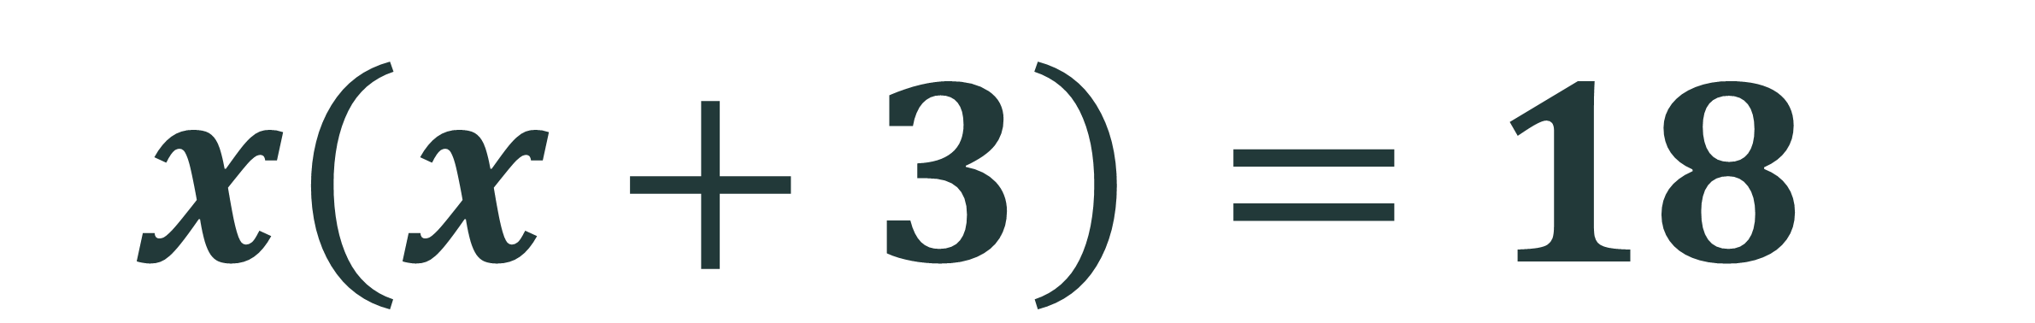
$$x\left(x+3\right)=18$$

Slide 9




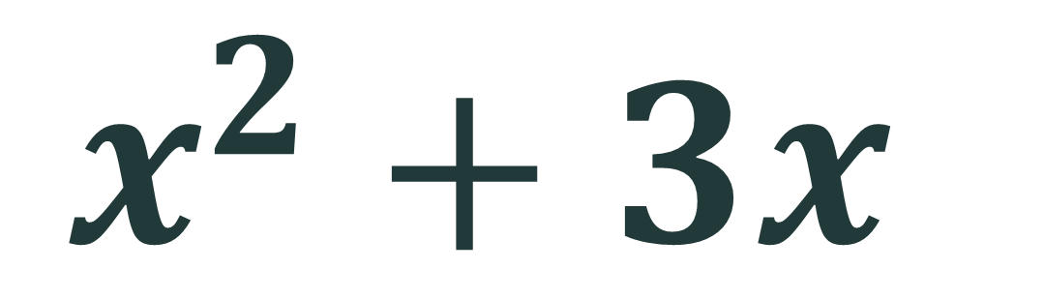


$$x\left(x+3\right)=18$$
$$x^{2}$$
$$+ 3x$$
$$=18$$
$$x^{2}+3x$$
$$−18$$
$$=0$$

Slide 10
Quadratic equations

Slide 11
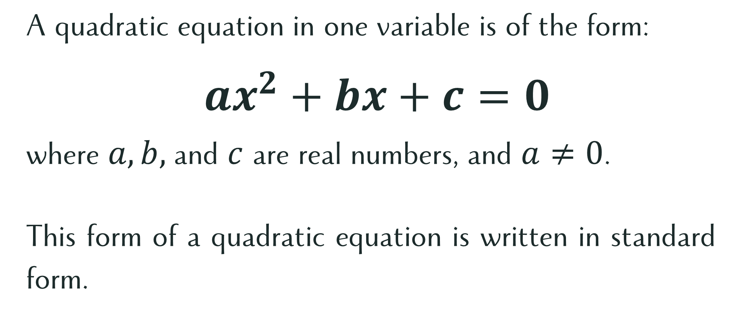
What is a Quadratic Equation?
A quadratic equation in one variable is of the form:
$ax^{2}+bx+c=0$
where $a, b,$and $c$ are real numbers, and $a≠0$.
This form of a quadratic equation is written in standard form.

Slide 12
$$x\left(x+3\right)=18$$
$$x^{2}$$
$$+ 3x$$
$$=18$$
$$x^{2}+3x$$
$$−18$$
$$=0$$

Slide 13
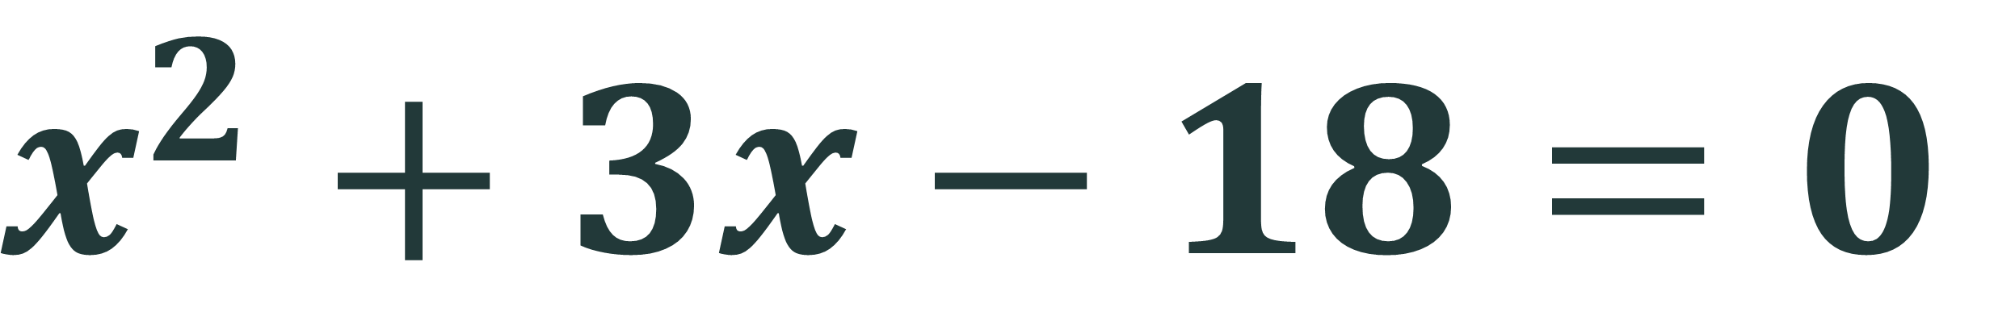
$$x^{2}+3x−18=0$$

Slide 14

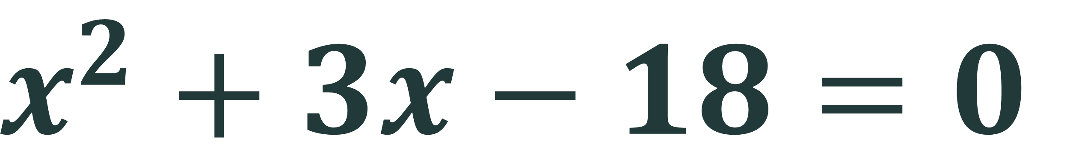
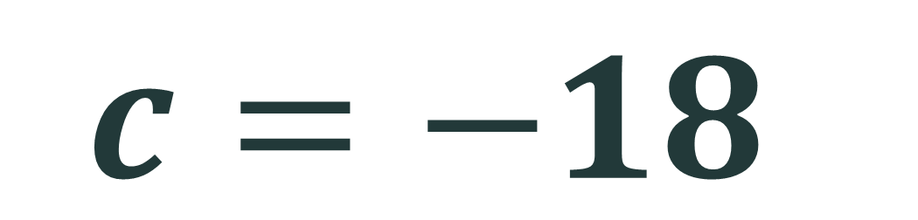

$$x^{2}+3x−18=0$$
$$a=1$$
$$b=3$$
$$c=−18$$

Slide 15

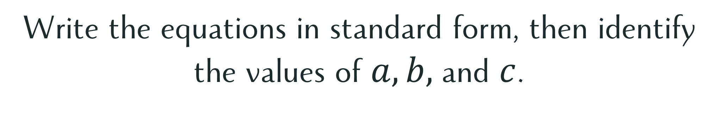
Let’s Try This!
Write the equations in standard form, then identify the values of $a, b,$and $c$.
Answers:
$3x^{2}+4x+4=0$
$2x^{2}+6x−3=0$
$x\left(2x−3\right)=0$
$\left(x+2\right)\left(3x−1\right)=0$

Slide 16
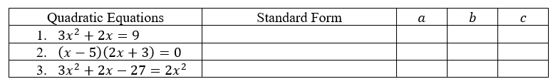
Comprehension Check
Check your understanding by completing the table below.

Slide 17
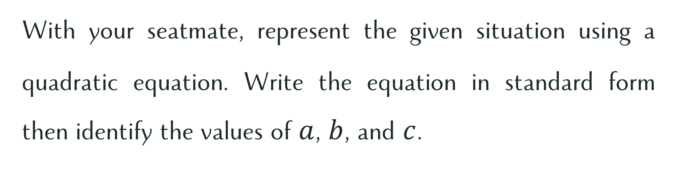
Let’s Work Together!
With your seatmate, represent the given situation using a quadratic equation. Write the equation in standard form then identify the values of $a$, $b$, and $c$.

Slide 18
A local charity organization is planning to build a rectangular shelter area for distributing food and providing temporary accommodation for the poor and homeless. The length of the shelter area is 4 meters more than twice its width. The total area of the shelter must be 150 square meters to adequately serve the community. Write the quadratic equation that would represent the area of the rectangular shelter area?

Slide 19
Compassion
Today’s given scenarios used Mathematics to help the people in need. Why is it important to use your knowledge and skills to help improve the lives of others?

